Slide 1
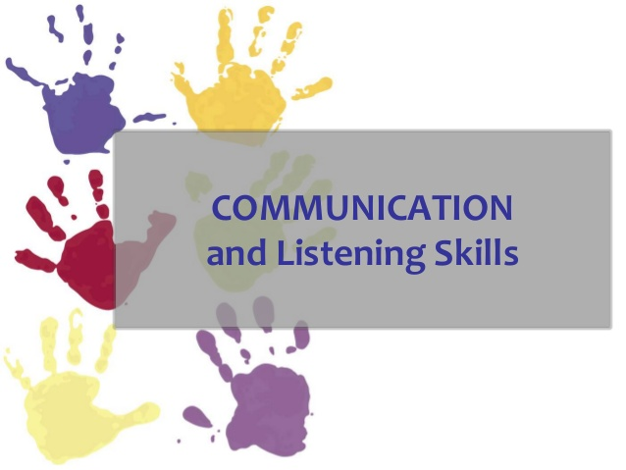
Listening Interactive Communication about Engineering Risk
by John X. Wang

Slide 2
Text Book
WHAT EVERY ENGINEER SHOULD KNOW ABOUT BUSINESS COMMUNICATION
Listening Interactive Communication about Engineering Risk
by John X. Wang

Slide 3
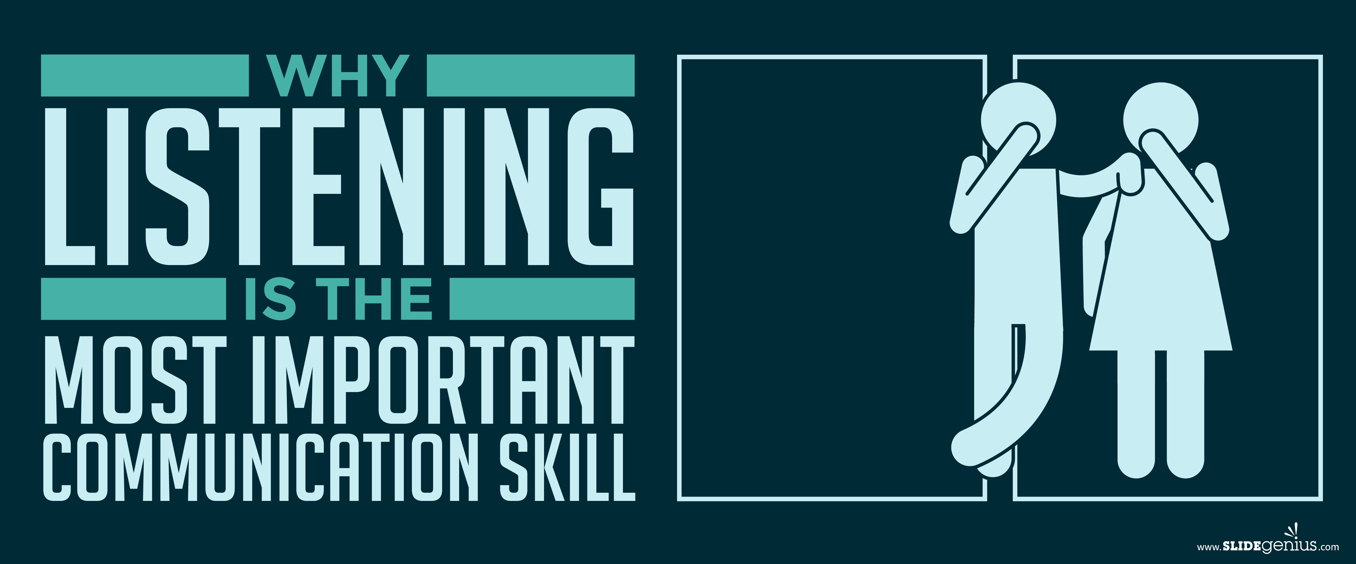
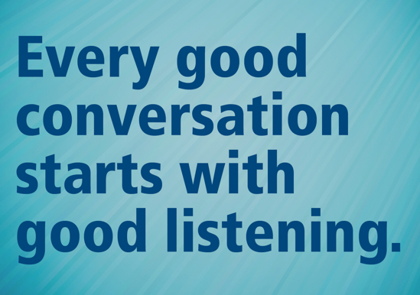
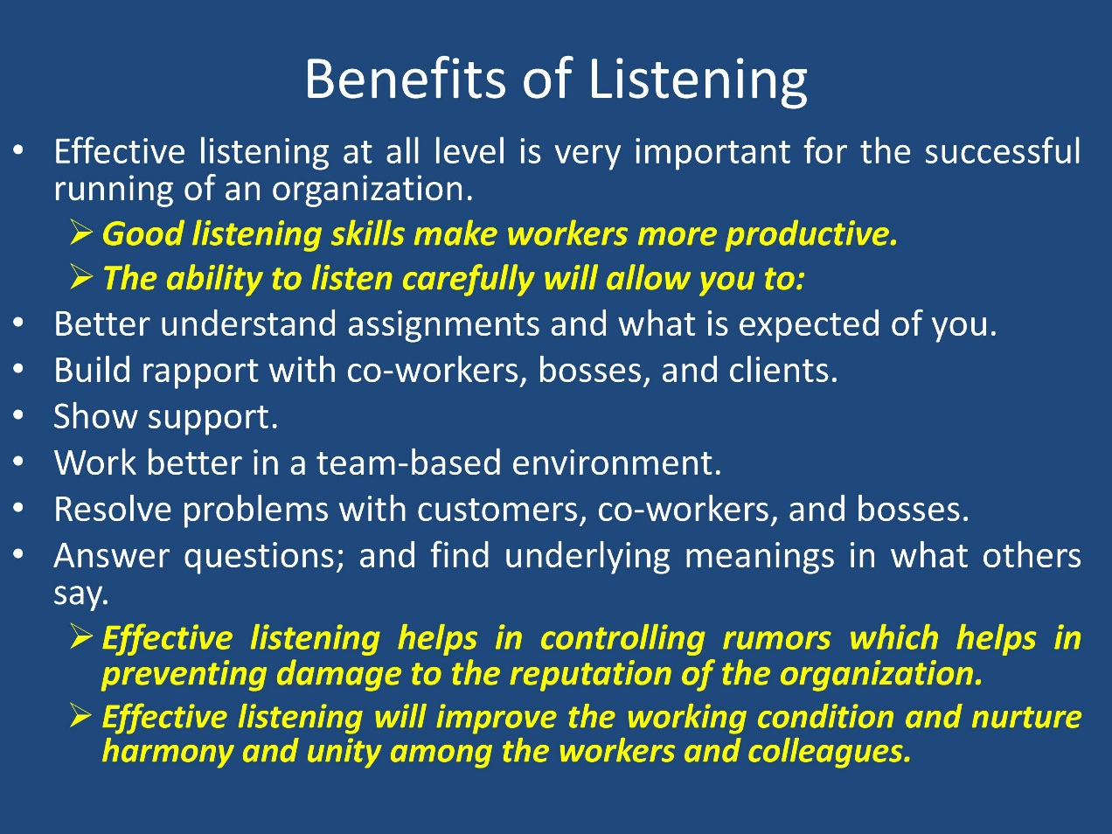

Slide 4
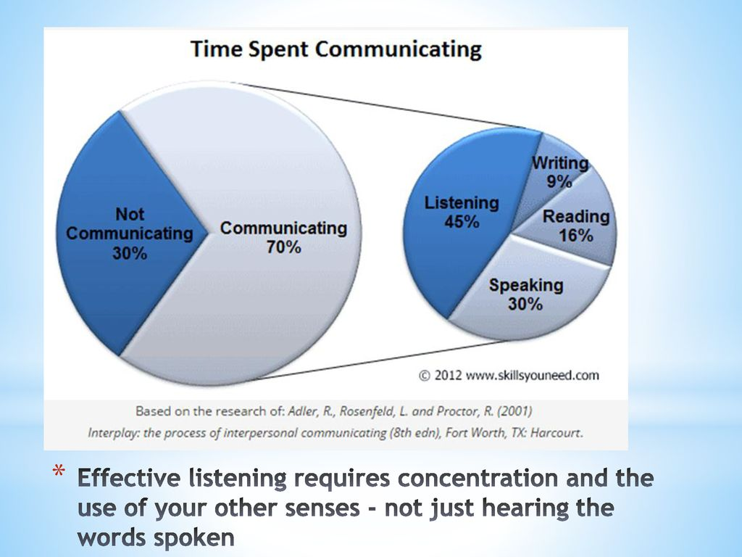

Being able to listen well is crucial to workplace communication skills in any job role.
Great listening skills will allow you to perform better, communicate more effectively, understand more, and feel like a part of the team. Great listening skills from both managers and employees will lead to a better working relationship.
if one party has information that the other lacks. This is said to cause market failure.

Slide 5
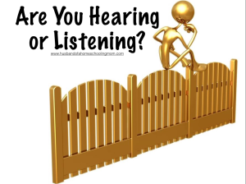
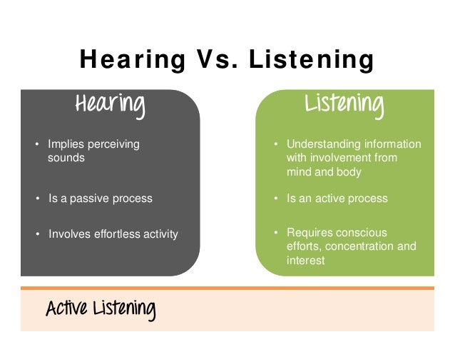

Slide 6
Listening—A Forgotten Risk
The more effectively you listen, the more effectively you communicate. However, only about 25% of listeners grasp the central ideas in business communications
Poor Listener | Effective Listener
Tends to “wool-gather” with slow speakers. | Thinks and mentally summarizes, listens between the lines to tones of voice and evidence.
Subject is dry, so tunes out speaker | Finds “what’s in it for me”
Takes intensive notes, but the more notes taken, the less value; has only one way to take notes | Has two to three ways to take notes and organize important information

Slide 7
Listening—A Forgotten Risk
Poor Listener | Effective Listener
Is over stimulated, and tends to seek and enter into arguments | Does not judge until comprehension is complete
Shows no energy output | Holds eye contact and helps speaker along by showing an active body state
Listens for facts | Listens for main ideas.
Interrupts the speaker | Lets the speaker finish.
Busy thinking about what he or she wants to say next | Lets himself or herself finish listening before he or she begins to speak

Slide 8
When is Listening Important?
Listening well is a skill that everyone needs, as it is required in nearly all work activities. Areas where listening skills are important include:
Teamwork. When team members listen to each other they are better able to share ideas and solve problems.
Decision Making. Making the best possible decisions requires knowing all of the available information, and in order to know all of the information you need to listen to it and absorb it.
Managing and Supervising. Mangers need to listen with empathy, compassion and respect. This will allow employees to feel valued and trusted.
Customer Service. Listening patiently and helping the customer fully express their issue can provide the extra insight needed to answer questions and solve problems in a way to satisfy the customer.
Sales. Listening to a customer’s needs before you start talking about the sale can provide the information you need to tailor your presentation to the client/customer.
Negotiation. If you listen with an open mind, you can find clues as to what terms the other party will and won’t accept.

Slide 9
Listening—Harder Than Speaking and Writing
What Causes Listening to Fail
1. Rehearsing- All your attention is on designing and preparing your next comment. You look interested, but your mind is going a mile a minute because you are thinking about what to say next. Some people rehearse entire chains of responses: “I’ll say, then he’ll say, and so on.”
2. Judging- A basic rule of listening is that judgments should only be made after you have heard and evaluated the content of the message.
3. Identifying- Refer it back to your own experience, often launching into your story before they can finish theirs.
4. Advising- You are the great problem solver. You do not have to hear more than a few sentences before you begin searching for the right advice.

Slide 10
What Causes Listening to Fail
5. Sparring-This block has you arguing and debating with people who never feel heard because you are so quick to disagree. In fact, your main focus is on finding things with which you disagree.
6. Being Right- You cannot listen to criticism, you cannot be corrected, and you cannot take suggestions for change.
7. Derailing- This listening block involves suddenly changing the subject. You derail the train of conversation when you get uncomfortable or bored with a topic. Another way of derailing is by joking.
8. Placating- Right … Absolutely … I know … Of course you are … Incredible … Really?
You want to be nice, pleasant, and supportive. You want people to like you, so you agree with everything. You may half-listen just enough to get the drift, but you are not really involved.
9. Dreaming- When we dream, we pretend to listen.

Slide 11
How to Listen a voice about Risk
The National Research Council (NRC) defines risk communication as “an interactive process of exchange of information and opinion among individuals, groups, and institutions.”
1. Give 100% Attention. Prove you care by suspending all other activities. Give your full attention to the person who is speaking. Make sure your mind is focused, too. An open mind is a mind that is receiving and listening to information.
2. Let the speaker finish before you begin to talk.
3. Listen for main ideas. These points may be mentioned at the beginning or end of a talk, and repeated a number of times.
4. Ask questions.
5. Give feedback.

Slide 12
How to Listen a voice about Risk
6. Thinking fast: Thoughts move about four times faster than speech .
7. Respond: Responses can be both verbal and nonverbal (i.e., nods, expressing interest)
8. Prove understanding: To say, “I understand” is not enough. People need some sort of evidence or proof of understanding.
9. Prove respect: Prove you take other views seriously. It seldom helps to say, “I appreciate your position” or “I know how you feel.” You have to prove it by your willingness to communicate with others at their level of understanding and attitude.

Slide 13
Listen Attentively
Attentive listening means thinking and acting in ways that connect you with the speaker.
By contrast, when people “multitask” while someone speaks, they rarely listen effectively. Of course, sometimes you will choose not to listen attentively. If listening is important to you, you may choose to reschedule that conversation.
You can take several simple steps to improve your listening skills
Get over yourself; give the speaker a solo.
Stop multitasking.
Recap regularly.
Use connecting words. Where it helps, use words that show you are connecting with what the person is saying, such as “uh huh,” “OK,” “yeah,” “I get it,” and so forth.
Use body language. Use positive body language

Slide 14
